Slide 1

Subject Name : Data Structures and Algorithms
Subject Code : 22CSE108
Total Contact Hours : 45
Credits : 03 L-T-P : 1-1-2
FACULTY OF
ENGINEERING
AND TECHNOLOGY

Slide 2

Course Objectives
• Describe the fundamentals of data structures and their applications essential for programming/problem solving.
• Demonstrate operations like searching, sorting, Insertion, deletion, traversing component to create solutions of diversified problems.
• Apply the concepts of data structures in different areas like DBMS, Compiler, Operating system etc.
• Choose efficient data structure and apply them to solve problems.

Slide 3

Course Outcomes
• Demonstrate the different programming constructs to solve computational problems.
• Implement basic data structures such as arrays, linked lists, stacks and queues.
• Use optimised algorithms for solving problems like sorting, searching, insertion and deletion of data.
• Solve computation problems using trees and graphs.
• Illustrate hash functions, collision detection techniques and
its resolution methods.
Use appropriate data structures focusing space and time
complexity for a given problem specification.

Slide 4
Module - 1
Introduction to Data Structures and Algorithms
Course overview, introduction to the data structure, motivation, need for data structures, understanding the role of data structures for efficient data processing, classification of data structures. Brief idea of algorithms, Asymptotic notations, the notion of time and space complexity. Introduce object-oriented programming (using Java).
Arrays: Representation of Linear Arrays in Memory, Single-Dimensional Arrays With Traversal, Selection, Searching, Insertion, Deletion, Sorting Operations. Two-Dimensional Arrays, Array of Strings, Multidimensional Arrays, Variable Length Arrays, Pointers and Arrays, Dynamically Allocated Arrays. Sets and Maps.
FACULTY OF
ENGINEERING
AND TECHNOLOGY
Faculty Name : Dr. Vianny

Slide 5
Module - 2
Stacks, Queues, Linked Lists and Recursion -
Conceptual understanding of Stacks, Queues and Linked Lists as data structures, various operations. Applications. Understanding when to use which data structure
Recursion: Design of Recursive Algorithms, Simple Recursion and Recursion Tree, Tower of Hanoi Problem, Recursion applications.
FACULTY OF
ENGINEERING
AND TECHNOLOGY
Faculty Name : Dr. Vianny

Slide 6
Module - 3
Trees and Graphs -
Definition of Trees, Binary Trees, Traversals and Threads, Binary Search Trees, Insertion and Deletion Algorithms, AVL Tree - Height-Balanced and Weight-Balanced Trees, B-Trees, B+ Trees, Heap Tree, Application of Trees; Hash tables; Graphs -Representations, Graphs Traversals - Breadth-First And Depth-First Search, Applications of Graphs – Model of www, Resource Allocation Graph
FACULTY OF
ENGINEERING
AND TECHNOLOGY
Faculty Name : Dr. Vianny

Slide 7
Module - 4
Sorting and Searching - Classification of Sorting Methods, Bubble Sort, Selection Sort, Insertion Sort, Quick Sort, Merge Sort, Heap Sort And Radix Sort, Classification of Searching, Linear Search, Binary Search, Hashing Functions – Division Reminder, Mid Square Method, Folding Method; Collision Resolution Techniques. String search and matching.
FACULTY OF
ENGINEERING
AND TECHNOLOGY
Faculty Name : Dr. Vianny

Slide 8
Module - 5
File Structures - Sequential and Direct Access, Index Sequential, Relative Files, Indexed Files - B+ Tree as Index, Multi-Indexed Files, Inverted Files, Hashed Files
FACULTY OF
ENGINEERING
AND TECHNOLOGY
Faculty Name : Dr. Vianny

Slide 9
Module - 1
Introduction to Data Structure
FACULTY OF
ENGINEERING
AND TECHNOLOGY

Slide 10

Definition
• Data is assumed as values or set of values - Entered through system’s input and stored as Files.
• A powerful and efficient storage mechanism is required for representation of data physically on the hard disk or computer’s memory to preserve the logical relationships.
• A storage and organization structure is required which enables efficiency by allowing the users manage all the data access or retrievals.

Slide 11
Definition
• The representation of particular data structure in the main memory of a computer is called as storage structure.
• The storage structure representation in auxiliary memory(secondary storage) is called as file structure.
FACULTY OF
ENGINEERING
AND TECHNOLOGY

Slide 12
Definition
• Data Structure is a way of collecting and organising data in such a way that we can perform operations on
these data in an effective way.
• A data structure is a class of data that can characterized
by its organization and the operations that are defined on it. Hence
• Data Structure= Organized Data + Allowed Operations
FACULTY OF
ENGINEERING
AND TECHNOLOGY

Slide 13
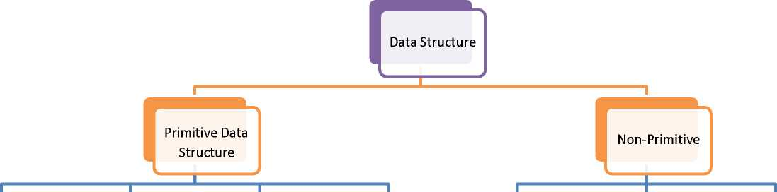
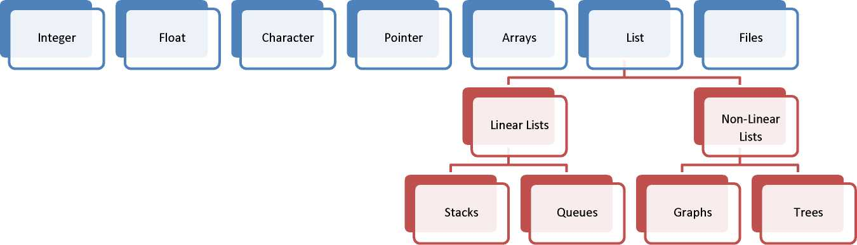
Classification of Data Structure
FACULTY OF
ENGINEERING
AND TECHNOLOGY

Slide 14
Primitive Data Structure:- The data structure that are atomic or
indivisible are called primitive. Example are integer, real, float, Boolean and characters.
Non-Primitive data structure:- The data structure that are not atomic are called non primitive or composite.
Examples are records, arrays and strings. These are more sophisticated. The non primitive data structures emphasize on structuring a group of homogenous or heterogeneous data items.

Slide 15
Linear Data Structure:- In a linear data structure, the data items are arranged in a linear sequence. Example is array. Non Linear data structure:- In a non-linear data structure, the data items are not in sequence. Example is tree.
FACULTY OF
ENGINEERING
AND TECHNOLOGY

Slide 16

Homogenous Data Structure:- In homogenous data structure, all the elements are of same type. Example is array.
Non Homogenous Data Structure:- In non-homogenous structures, all the elements may or may not be of the same types. Example is records.

Slide 17
Static Data Structure:- Static structures are ones whose sizes, structures, and associated memory location are fixed at compile time.
Dynamic Data Structure:- Dynamic structures are ones which expand or shrink as required during the program execution and their associated memory location changes.

Slide 18
Operations on data structure
• Create
• Selection
• Deletion
• Updation Other Operations
Searching
Sorting
Merging
FACULTY OF
ENGINEERING
AND TECHNOLOGY

Slide 19

Operations on data structure
• Design of efficient data structure must take operations to be performed on the data structures into account. The most
1. Create:- The create operation results in reserving memory for program elements. This can be done by declaration statement. Creation of data structure may take place either during compile-time or run-time. malloc() function of C language is used for creation.
2. Destroy:- Destroy operation destroys memory space allocated for specified data structure. free() function of C language is used to destroy data structure.
3. Selection:- Selection operation deals with accessing a particular data within a data structure.
4. Updation:- It updates or modifies the data in the data structure.

Slide 20
Operations on data structure
• Searching:- It finds the presence of desired data item in the list of data items, it may also find the locations of all elements that satisfy certain conditions.
• Sorting:- Sorting is a process of arranging all data items in a data structure in a particular order, say for example, either in ascending order or in descending order.
• Merging:- Merging is a process of combining the data items of two different sorted list into a single sorted list.
• Splitting:- Splitting is a process of partitioning single list to multiple list.
• Traversal:- Traversal is a process of visiting each and every node of a list in systematic manner.
FACULTY OF
ENGINEERING
AND TECHNOLOGY

Slide 21
Advantages of data structure
• Efficiency: Efficiency of a program depends upon the choice of data structures.
• Reusability: Data structures are reusable, i.e. once we have implemented a particular data structure, we can use it at any other place. Implementation of data structures can be compiled into libraries which can be used by different clients.
• Abstraction: Data structure is specified by the ADT which provides a level of abstraction.
FACULTY OF
ENGINEERING
AND TECHNOLOGY

Slide 22
Need of Data Structure
• Storing data - Data structures are used for efficient data persistence, such as specifying the collection of attributes and corresponding structures used to store records in a database management system.
• Managing resources and services. Core operating system (OS) resources and services are enabled through the use of data structures such as linked lists for memory allocation, file directory management and file structure trees
• Data exchange. Data structures define the organization of information shared between applications, such as TCP/IP packets.
FACULTY OF
ENGINEERING
AND TECHNOLOGY

Slide 23
Need of Data Structure
• Ordering and sorting - Data structures such as binary search trees -- also known as an ordered or sorted binary tree -- provide efficient methods of sorting objects, such as character strings used as tags. With data structures such as priority queues, programmers can manage items organized according to a specific priority..
• Indexing - Even more sophisticated data structures such as B-trees are used to index objects, such as those stored in a database.
• Searching - Indexes created using binary search trees, B-trees or hash tables speed the ability to find a specific sought-after item.
FACULTY OF
ENGINEERING
AND TECHNOLOGY

Slide 24
Need of Data Structure
• Scalability - Big data applications use data structures for allocating and managing data storage across distributed storage locations, ensuring scalability and performance.
Certain big data programming environments -- such as Apache Spark, provide data structures that mirror the underlying structure of database records to simplify querying.
FACULTY OF
ENGINEERING
AND TECHNOLOGY

Slide 25
Algorithm-definition
• An algorithm is a finite set of instructions which, if followed, accomplish a particular task.
In addition every algorithm must satisfy the following criteria:
1. Input: there are zero or more quantities which are externally supplied
2. Output: at least one quantity is produced
3. Definiteness: each instruction must be clear and unambiguous
4. Finiteness: if we trace out the instructions of an algorithm, then for all cases the algorithm will terminate after a finite number of steps
5. Effectiveness: every instruction must be sufficiently basic that it can in principle be carried out by a person using only pencil and paper.
FACULTY OF
ENGINEERING
AND TECHNOLOGY

Slide 26
Algorithm-definition
• If we have an algorithm for a specific problem, then we can implement it in any programming language, meaning that the algorithm is independent from any programming languages
• The important aspects of algorithm design include creating an efficient algorithm to solve a problem in an efficient way using minimum time and space
• Properties of Algorithms
Correctness
Simplicity
FACULTY OF
ENGINEERING
AND TECHNOLOGY

Slide 27
Algorithm-definition
• Correctness of an algorithm is asserted when it is said that the algorithm is correct with respect to a specification
• Functional correctness refers to the input-output behavior of the algorithm (i.e., for each input it produces the expected output)
FACULTY OF
ENGINEERING
AND TECHNOLOGY

Slide 28
Algorithm- Example
• Algorithm Greatest_of_Three_Nos
//Algorithm to find the greatest of three numbers
//Input: Three integers
//Output: Displays the greatest among the three nos.
Step 1. Start
Step 2. Read three numbers a, b, c.
Step 3. Check if(a>b) and (a>c), then a is gratest
Step 4. else, if(b>c), then b is gratest
Step 5. c is gratest.
Input a=10, b=5, c=15 ; works properly
Input a=5, b=10, c=15 ; works properly
Input a=5, b=15, c=10 ; works properly
FACULTY OF
ENGINEERING
AND TECHNOLOGY

Slide 29
Analysis of Algorithm
• The algorithm can be analyzed by tracing all step-by-step instructions, reading the algorithm for logical correctness, and testing it on some data using mathematical techniques to prove it’s correctness.
• Design the algorithm in a simple way so that it becomes easier to be implemented
• However, the simplest and most straight forward way of solving a problem may not be sometimes the best one
• The choice of a particular algorithm depends on following performance analysis and measurements:
Space complexity
Time complexity
FACULTY OF
ENGINEERING
AND TECHNOLOGY

Slide 30
Space Complexity
Space complexity of an algorithm or program is the amount of memory it needs to run to completion
Some of the reasons for studying space complexity are:
If the program is to run on multi user system, it may be required to specify the amount of memory to be allocated to the program
We may be interested to know in advance that whether sufficient memory is available to run the program
There may be several possible solutions with different space requirements
Can be used to estimate the size of the largest problem that a program can solve
FACULTY OF
ENGINEERING
AND TECHNOLOGY

Slide 31
The space needed by a program consists of following components
Instruction space : Space needed to store the executable version of the program and it is fixed
Data space : Space needed to store all constants, variable values and has further two components :
Space needed by constants and simple variables. This space is fixed.
Space needed by fixed sized structural variables, such as arrays and structures
Dynamically allocated space. This space usually varies
Environment stack space: This space is needed to store the information to resume the suspended (partially completed) functions. Each time a function is invoked the following data is saved on the environment stack :
Return address : i.e., from where it has to resume after completion of the Called function
Values of all lead variables and the values of formal parameters in the function being invoked
FACULTY OF
ENGINEERING
AND TECHNOLOGY

Slide 32
Space Complexity
The amount of space needed by recursive function is called the recursion stack space.
For each recursive function, this space depends on the space needed by the local variables and the formal parameter.
FACULTY OF
ENGINEERING
AND TECHNOLOGY

Slide 33
Time Complexity
The time complexity of an algorithm or a program is the amount of time it needs to run to completion.
The exact time will depend on the implementation of the algorithm, programming language, optimizing the capabilities of the compiler used, the CPU speed, other hardware characteristics/specifications and so on
To measure the time complexity accurately, we have to count all sorts of operations performed in an algorithm
If we know the time for each one of the primitive operations performed in a given computer, we can easily compute the time taken by an algorithm to complete its execution. This time will vary from machine to machine
FACULTY OF
ENGINEERING
AND TECHNOLOGY

Slide 34
Time Complexity
By analyzing an algorithm, it is hard to come out with an exact time required
To find out exact time complexity, we need to know the exact instructions executed by the hardware and the time required for the instruction
The time complexity also depends on the amount of data inputted to an algorithm. But we can calculate the order of magnitude for the time required
The time complexity also depends on the amount of data input to an algorithm, but we can calculate the order of magnitude for the time required
That is, our intention is to estimate the execution time of an algorithm irrespective of the computer machine on which it will be used
FACULTY OF
ENGINEERING
AND TECHNOLOGY

Slide 35
Some of the reasons for studying time complexity are;
We may be interest to know in advance that whether an algorithm or program will provide a satisfactory real time response
There may be several possible solutions with different time requirements
Here, the more sophisticated method is to identify the key operations and count such operations performed till the program completes its execution
A key operation in our algorithm is an operation that takes maximum time among all possible operations in the algorithm
Such an abstract, theoretical approach is not only useful for discussing and comparing algorithms, but also it is useful to improve solutions to practical problems
The time complexity can now be expressed as function of number of key operations performed
FACULTY OF
ENGINEERING
AND TECHNOLOGY

Slide 36
When we analyze an algorithm it depends on the input data, there are three cases :
Best case
Average case
Worst case
In the best case, the amount of time a program might be expected to take on best possible input data.
In the average case, the amount of time a program might be expected to take on typical (or average) input data
In the worst case, the amount of time a program would take on the worst possible input configuration
FACULTY OF
ENGINEERING
AND TECHNOLOGY

Slide 37
Frequency Count
Frequency count method can be used to analyze a program
Here we assume that every statement takes the same constant amount of time for its execution.
Hence the determination of time complexity of a given program is just matter of summing the frequency counts of all the statements of that program
FACULTY OF
ENGINEERING
AND TECHNOLOGY

Slide 38
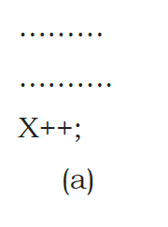
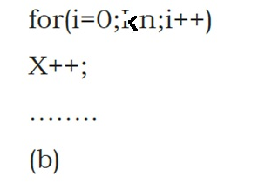
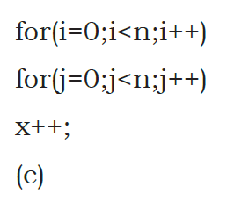
Frequency Count
Consider the examples
In (a) the statement X++ executes only once; frequency count is 1
In (b) the statement X++ executes n times; frequency count is n
In (c) the statement x++ executes n*n times; frequency count is n²
FACULTY OF
ENGINEERING
AND TECHNOLOGY

Slide 39
Asymptotic Notations
Asymptotic notations are the mathematical notations used to describe the running time of an algorithm when the input tends towards a particular value or a limiting value.
Commonly used asymptotic notations are
Big Oh (O)
Big Omega (Ω)
Theta (Ө)
Littile Oh (o)
Little Omega(ῴ)
FACULTY OF
ENGINEERING
AND TECHNOLOGY

Slide 40
Asymptotic Notations
Big Oh Notation, Ο
The Big Oh is the formal way to express the upper bound of an algorithm's running time.
It measures the worst case time complexity or longest amount of time an algorithm can possibly take to complete.
The function f(n) = O(g(n)) if and only if there exist positive constants c, n0 such that
f(n) <- cg(n), for all n >- n0.
Big-oh can be used to denote all upper bounds on the time complexity of an algorithm.
Big-oh also captures the worst case analysis of an algorithm.
For any value of n, the running time of an algorithm does not cross the time provided by O(g(n)).
FACULTY OF
ENGINEERING
AND TECHNOLOGY

Slide 41
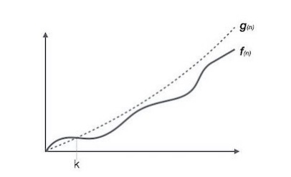
Asymptotic Notations
Big Oh Notation, Ο
FACULTY OF
ENGINEERING
AND TECHNOLOGY

Slide 42
Asymptotic Notations
Omega Notation, Ω
The Ωn is the formal way to express the lower bound of an algorithm's running time.
It measures the best case time complexity or best amount of time an algorithm can possibly take to complete.
The function f(n) = omega (g(n)) if and only if there exist positive constants c, n0 such that
f(n) >- c.g(n); for all n >- n0.
Omega can be used to denote all lower bounds of an algorithm.
Omega notation also denotes the best case analysis of an algorithm.
For any value of n, the minimum time required by the algorithm is given by Omega Ω(g(n)).
FACULTY OF
ENGINEERING
AND TECHNOLOGY

Slide 43
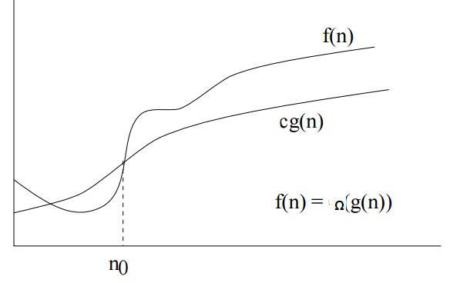
Asymptotic Notations
Omega Notation, Ω
FACULTY OF
ENGINEERING
AND TECHNOLOGY

Slide 44
Asymptotic Notations
Theta Notation, θ
The θn is the formal way to express both the lower bound and upper bound of an algorithm's running time.
The function f(n) = Theta(g(n)) if and only if there exist positive constants c1; c2; n0 such that
c1g(n) <- f(n) <- c2g(n), for all n >- no.
Theta can be used to denote tight bounds of an algorithm.
g(n) is a lower bound as well as an upper bound for f(n).
Since it represents the upper and the lower bound of the running time of an algorithm, it is used for analyzing the average-case complexity of an algorithm.
If a function f(n) lies anywhere inbetween c₁g(n) and c₂g(n) for all n ≥ n0, then f(n) is said to be asymptotically tight bound.
FACULTY OF
ENGINEERING
AND TECHNOLOGY

Slide 45
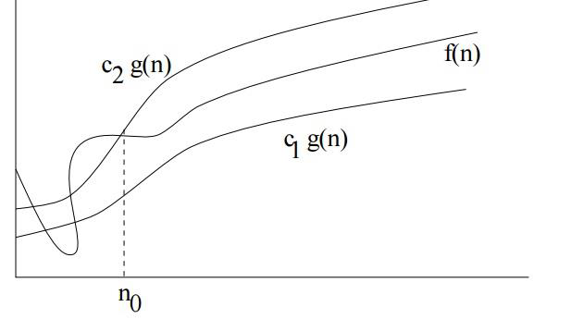
Asymptotic Notations
FACULTY OF
ENGINEERING
AND TECHNOLOGY

Slide 46
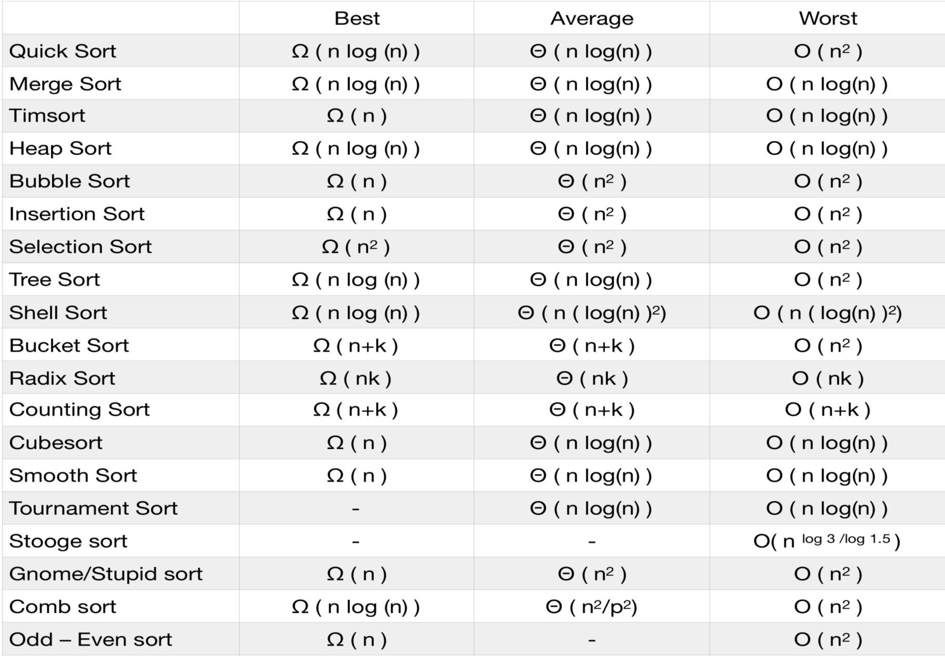
Asymptotic Notations
FACULTY OF
ENGINEERING
AND TECHNOLOGY

Slide 47
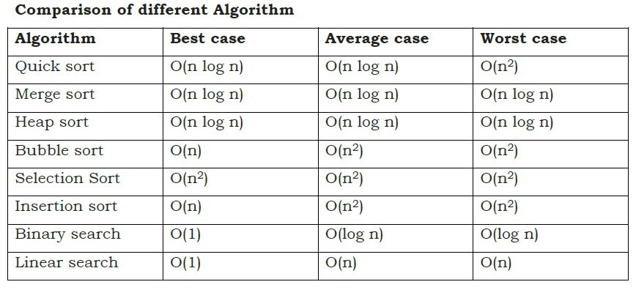
Asymptotic Notations
FACULTY OF
ENGINEERING
AND TECHNOLOGY

Slide 48
Object Oriented Programming
Object-oriented programming (OOP) is a programming paradigm based on the concept of “objects”.
Objects may contain data, in the form of fields, often known as attributes; and code, in the form of procedures, often known as methods.
Objects And Classes
Class - A class can be defined as a template/blueprint that describes the behavior/state that the object of its type support.
Object – Is and instance of class , Objects have states and behaviors.
FACULTY OF
ENGINEERING
AND TECHNOLOGY

Slide 49
Object Oriented Programming
Classes in Java
A class is a blueprint from which individual objects are created.
example of a class.
public class Dog {
String breed;
int age;
String color;
void barking()
{
}
}
FACULTY OF
ENGINEERING
AND TECHNOLOGY

Slide 50
Object Oriented Programming
Classes in Java
A class can contain any of the following variable types.
Local variables − Variables defined inside methods, constructors or blocks are called local variables.
Instance variables − Instance variables are variables within a class but outside any method.
These variables are initialized when the class is instantiated.
Instance variables can be accessed from inside any method, constructor or blocks of that particular class.
Class variables − Class variables are variables declared within a class, outside any method, with the static keyword.
FACULTY OF
ENGINEERING
AND TECHNOLOGY

Slide 51
Object Oriented Programming
OOP Concepts In Java
OOP concepts in Java are the main ideas behind Java’s Object Oriented Programming. They are:
Object - Any entity that has state and behavior is known as an object. It can be either physical or logical.
Class & Instance - Collection of objects of the same kind is called class. It is a logical entity.
A class can be visualized as a three-compartment box, as illustrated:
1. Name (or identity): identifies the class.
2. Variables (or attribute, state, field): contain the static attributes of the class.
3. Methods (or behaviors, function, operation): contain the dynamic behaviors of the class.
FACULTY OF
ENGINEERING
AND TECHNOLOGY

Slide 52
Object Oriented Programming
OOP Concepts In Java
Abstraction - Abstraction refers to the quality of dealing with ideas rather than events.
It basically deals with hiding the details and showing the essential things to the user
In java, we use abstract class and interface to achieve abstraction.
Abstract class: - Abstract class in Java contains the ‘abstract’ keyword.
If a class is declared abstract, it cannot be instantiated.
So we cannot create an object of an abstract class.
An abstract class can contain abstract as well as concrete methods.
FACULTY OF
ENGINEERING
AND TECHNOLOGY

Slide 53
Object Oriented Programming
OOP Concepts In Java
Interface: - Interface in Java is a collection of abstract methods and static constants.
In an interface, each method is public and abstract but it does not contain any constructor.
Along with abstraction, interface also helps to achieve multiple inheritance in Java.
So an interface is a group of related methods with empty bodies.
FACULTY OF
ENGINEERING
AND TECHNOLOGY

Slide 54
Object Oriented Programming
OOP Concepts In Java
Encapsulation - Binding (or wrapping) code and data together into a single unit is known as encapsulation.
It means to hide our data in order to make it safe from any modification.
Through encapsulation the methods and variables of a class are well hidden and safe.
Encapsulation can be achieved in Java by:
Declaring the variables of a class as private.
Providing public setter and getter methods to modify and view the variables values.
FACULTY OF
ENGINEERING
AND TECHNOLOGY

Slide 55
Object Oriented Programming
OOP Concepts In Java
Inheritance - This is a special feature of Object Oriented Programming in Java.
It lets programmers create new classes that share some of the attributes of existing classes.
For eg, a child inherits the properties from his father.
Similarly, in Java, there are two classes:
1. Parent class (Super or Base class)
2. Child class (Subclass or Derived class)
A class which inherits the properties is known as ‘Child class’ whereas a class whose properties are inherited is known as ‘Parent class”.
FACULTY OF
ENGINEERING
AND TECHNOLOGY

Slide 56
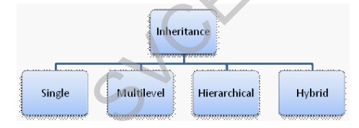
Object Oriented Programming
OOP Concepts In Java
Inheritance is classified into 4 types:
FACULTY OF
ENGINEERING
AND TECHNOLOGY

Slide 57
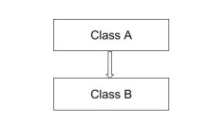
Object Oriented Programming
OOP Concepts In Java
Single Inheritance - It enables a derived class to inherit the properties and behavior from a single parent class.
Here, Class A is a parent class and Class B is a child class which inherits the properties and behavior of the parent class.
FACULTY OF
ENGINEERING
AND TECHNOLOGY

Slide 58
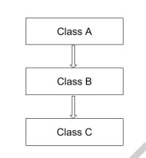
Object Oriented Programming
OOP Concepts In Java
Multilevel Inheritance - When a class is derived from a class which is also derived from another class.
i.e., a class having more than one parent class but at different levels, such type of inheritance is called Multilevel Inheritance.
Here, class B inherits the properties and behavior of class A and class C inherits the properties of class B.
Class A is the parent class for B and class B is the parent class for C. So, class C implicitly inherits the properties and methods of class A along with Class B.
FACULTY OF
ENGINEERING
AND TECHNOLOGY

Slide 59
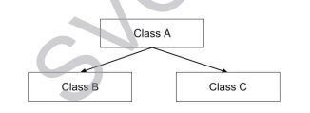
Object Oriented Programming
OOP Concepts In Java
Hierarchical Inheritance - When a class has more than one child class (sub class), then such kind of inheritance is known as hierarchical inheritance.
Here, classes B and C are the child classes which are inheriting from the parent class A.
FACULTY OF
ENGINEERING
AND TECHNOLOGY

Slide 60
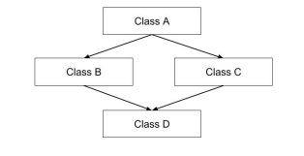
Object Oriented Programming
OOP Concepts In Java
Hybrid Inheritance - Hybrid inheritance is a combination of multiple inheritance and multilevel inheritance.
Since multiple inheritance is not supported in Java as it leads to ambiguity, this type of inheritance can only be achieved through the use of the interfaces.
Here, class A is a parent class for classes B and C, whereas classes B and C are the parent classes of D which is the only child class of B and C.
FACULTY OF
ENGINEERING
AND TECHNOLOGY

Slide 61
Object Oriented Programming
OOP Concepts In Java
Polymorphism - Polymorphism means taking many forms, where ‘poly’ means many and ‘morph’ means forms.
It is the ability of a variable, function or object to take on multiple forms.
In other words, polymorphism allows us to define one interface or method and have multiple implementations.
Polymorphism in Java is of two types:
• Run time polymorphism
• Compile time polymorphism
FACULTY OF
ENGINEERING
AND TECHNOLOGY

Slide 62
Object Oriented Programming
OOP Concepts In Java
Run time polymorphism: - In Java, runtime polymorphism refers to a process in which a call to an overridden method is resolved at runtime rather than at compile-time.
Method overriding is an example of run time polymorphism.
Compile time polymorphism - In Java, compile time polymorphism refers to a process in which a call to an overloaded method is resolved at compile time rather than at run time.
Method overloading is an example of compile time polymorphism.
FACULTY OF
ENGINEERING
AND TECHNOLOGY

Slide 63
Arrays
Arrays:- An array is defined as a set of finite number of homogenous elements or data items.
It means an array can contain one type of data only, either all integers, all floating point numbers or all characters.
Ex1:- int a[ ]= {1,2,3,4,5};
Ex2: char b[ ] = {‘a’, ‘b’, ‘c’};
Ex3: char c[ ] = “hi”;
The individual element of an array can be accessed by specifying name of the array, followed by index or subscript inside square bracket.
Exp. to access the 10th element statement will be a[9].
The first element of the array has index zero[0]. So in an array of 10 elements the first array will be a[0] and last a[9]
FACULTY OF
ENGINEERING
AND TECHNOLOGY

Slide 64
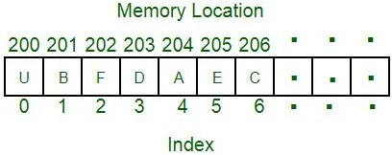
Arrays
The elements of array will always be stored in consecutive memory location.
The size of an array can be calculated by using this equation
(upper bound- lower bound )+1 .
Ex: (9-0)+1
Arrays can always be read or written through loop.
In case of one dimensional array it required one loop for reading and one loop for writing.
For two dimensional array it requires two loops for each Operation.
FACULTY OF
ENGINEERING
AND TECHNOLOGY

Slide 65

Arrays With Java
// declare an array
int[] age = new int[5];
// initialize array
age[0] = 12;
age[1] = 4;
age[2] = 5;
// access array elements
array[index]
FACULTY OF
ENGINEERING
AND TECHNOLOGY

Slide 66
Arrays With Java
Example: Access Array Elements
class Main {
public static void main(String[] args) {
// create an array
int age[] = {12, 4, 5, 2, 5};
// access each array elements
System.out.println("Accessing Elements of Array:");
System.out.println("First Element: " + age[0]);
System.out.println("Second Element: " + age[1]);
System.out.println("Third Element: " + age[2]);
System.out.println("Fourth Element: " + age[3]);
System.out.println("Fifth Element: " + age[4]);
}
}
FACULTY OF
ENGINEERING
AND TECHNOLOGY

Slide 67
Operations on arrays
Various operations that can be performed on array are
Traversal
Sorting
Searching
Insertion
Deletion
Merging etc.
FACULTY OF
ENGINEERING
AND TECHNOLOGY

Slide 68
Array Traversal
This operation is used to visit all elements in an array.
Algorithm ArrayTraverse ( A[L … U] ) i = L While i <= U do process(A[i] ) i = i + 1 End While Stop
Input: An array A with n elements Output: According to process( )
1.void ArrayTraverse( int A[20], int n) 2. int i=0; 3. for ( i=0; i < n; i++) 4. process ( A[i] ) ; 5. Stop
L = 0 U = n – 1

Slide 69
Sorting
The following algorithm is used to store the elements of an integer array in ascending order.
Algorithm ArraySort ( A[L … U] ) i = L While i <= U - 1 do j = i + 1 While j <= U do if ( A[i] > A[j] ) swap(A[i],A[j]) EndIf j = j + 1 EndWhile i = i + 1 EndWhile Stop
Input: An array A with integer data. Output: Sorted array
void ArraySort( int A[20], int n) { int i, j, temp; for ( i=0; i <= n-2; i++) { for(j=i+1; j <= n-1; j++) { if( A[i] > A[j] ) { temp = A[i]; A[i] = A[j]; A[j]= temp; } } } }

Slide 70
Searching
This operation is used to find the first position of an element of interest in an array.
Algorithm ArraySearch ( A[L … U] , KEY) i = L, found = 0, location = 0 While (i <= U ) and (found == 0) do If (A[i] == KEY) then found = 1 location = i Else i = i + 1 EndIf End While If found == 0 then print “Search is unsuccessful: KEY is not in the array” Else print “Search is successful: KEY is in the array at location” , location EndIf Return( location) Stop
Input: An array A with elements, KEY the element to be searched. Output: Position of KEY in A or a message of failure.

Slide 71
Searching Function
int ArraySearch( int[ ] A, int n, int KEY) { A = new int[size]; int i, found=0, location=0 ; for ( i=0; (i < n ) && (found ==0); i++) { if ( A[i] == KEY ) { found = 1; location = i + 1; } } if ( found == 0 ) System.out.println(“Search is unsuccessful: %d is not in the array\n”, KEY ); else System.out.println(“Search is successful: %d is in the array at location %d\n”, KEY,location); return ( location ) ; }
L = 0 U = n – 1

Slide 72
Insertion Algorithm
Insert an element KEY into an array A at the position LOCATION , provided that the array is not full.
Algorithm ArrayInsertion ( A[ L … U ], KEY, LOCATION ) If U == CAPACITY then Print “Array is Full: No insertion possible” Exit Else i = U + 1 While i > LOCATION do A[i] = A[i-1] i = i – 1 EndWhile A[LOCATION] = KEY EndIf Stop

Slide 73
Insertion
Consider an array of Capacity 5 with four elements in it.
Insert the data 13 at position 2.
Steps:
L =0
U =4
CAPACITY=5
24 | 4 | 17 | 9
i=5
i=4
24 | 4 | 17 | 9
24 | 4 | 17 | 9 | 9
i=3
i=2
24 | 4 | 17 | 17 | 9
24 | 4 | 4 | 17 | 9
24 | 4 | 4 | 17 | 9
24 | 13 | 4 | 17 | 9
13

Slide 74
Deletion Algorithm
Delete an element KEY from an array A with L and U as lower and upper bounds of array index.
Algorithm ArrayDelete ( A[ L … U ], KEY) i = ArraySearch( A, KEY ) If i == 0 then Print “KEY not found: No deletion possible” Exit Else While i < U do A[i] = A[i+1] i = i + 1 EndWhile EndIf A[U] = NULL U = U - 1 Stop
i is the index of element KEY.

Slide 75
Deletion
Consider an array of Capacity 5 with four elements in it.
Delete the data 4
Steps:
L =0
U =4
CAPACITY=5
24 | 4 | 17 | 9
i=2
i=3
24 | 4 | 17 | 9
24 | 17 | 17 | 9
i=4
i=4
24 | 17 | 9 | 9
24 | 17 | 9 | NULL
U= 3
24 | 17 | 9

Slide 76
Two Dimensional Arrays
Two dimensional arrays(Matrices) are a collection of homogeneous elements where the elements are ordered in a number of rows and columns.
In an m × n matrix
m denotes the number of rows
n denotes the number of columns
Logical representation of Two dimensional array
The subscript of any arbitrary element a_{ij}, represent
i^{th} row
j^{th} column

Slide 77
Memory representation of a matrix
Matrices are stored in contiguous memory locations.
There are two conventions of storing matrix in the memory.
Row major order method
The elements of a matrix are stored on a row by row basis.
First store all the elements in the first row, then the elements of second row, and so on.
Column major order method
The elements of a matrix are stored on a column by column basis.
First store all the elements in the first column, then the elements of second column, and so on.

Slide 78
Memory representation of a matrix
Consider a matrix A of order 3 × 4
Row major order method representation of A in the memory
Colum major order method representation of A in the memory

Slide 79
Address(Reference) of an element in a 2D array
Logically, a matrix appears as two dimensional
Physically, a matrix is stored in a linear fashion
To map from logical view to physical structure, indexing formula is used.
Let A be a two dimensional array of
order m × n
base address B.
The number of words per memory location for array A is W.
I = Row Subset of an element whose address to be found
J = Column Subset of an element whose address to be found
LR = Lower Limit of row/start row index of the matrix(If not given assume it as zero)
LC = Lower Limit of column/start column index of the matrix(If not given assume it as zero)
N = Number of column given in the matrix. N = Upper Bound – Lower Bound + 1
M = Number of rows given in the matrix. M = Upper Bound – Lower Bound + 1

Slide 80
Address(Reference) of an element in a 2D array
Indexing formula to find address of the element A[i][j] in
Row major method
Column major method

Slide 81
String Array
Strings represent a sequence of character.
Java String array is used to hold fixed number of Strings.
Java String array is basically an array of objects.
There are two ways to declare string array – declaration without size and declare with size.
There are two ways to initialize string array – at the time of declaration, populating values after declaration.
String Array Declaration.
String[ ] strArray; //declare without size
String[ ] strArray1 = new String[3]; //declare with size
String Array Initialization
String[ ] strArray1 = new String[] {"BMW","Ford","AUDI"}; //inline initialization
String[] strArray2 = {"BMW","Ford","AUDI"};

Slide 82
String Array
String[] strArray3 = new String[3]; //initialization after declaration
strArray3[0] = "BMW";
strArray3[1] = "FORD";
strArray3[2] = "AUDI";

Slide 83
Variable Length Array
Runtime sized or variable sized array.
Ie, the size of the array is defined at runtime.
Eg:
void fun(int n)
{
int arr[] = new int[n]; // ......
}
int main()
{
fun(6);
}

